Slide 1
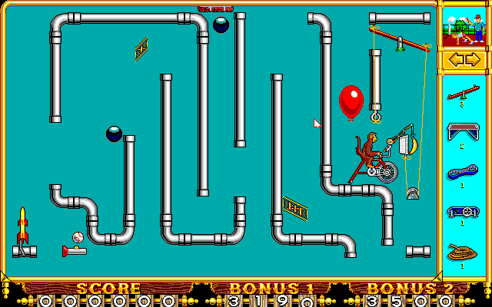

REACTIVE JAVA
Tomasz Kowalczewski

Slide 2
A little bit of history
A few words about API
Code!

Slide 4
Synchronous pull communication
Request
Client
Server
Response
Processing
Network latency

Slide 5
ASynchronous PUSH
Processing
Network latency

Slide 6
Observable stream
subscribe
Observer
Observable
onNext*
One of
unsubscribe
onCompleted
onError
t

Slide 7


Slide 8
Observable stream
Observer
subscribe
Observable
onNext*
unsubscribe | onCompleted | onError
t

Slide 9
Observable stream STATES
CREATED
ACTIVE
FINISHED
onNext
unsubscribe
subscribe
onCompleted | onError
server calls
client calls

Slide 10
Rx Java by Netflix
Open source project with Apache License.
Java implementation of Rx Observables from Microsoft
The Netflix API uses it to make the entire service layer asynchronous
Provides a DSL for creating computation flows out of asynchronous sources using collection of operators for filtering, selecting, transforming and combining that flows in a lazy manner
These flows are called Observables – collection of events with push semantics (as oposed to pull in Iterator)
Targets the JVM not a language. Currently supports Java, Groovy, Clojure, and Scala
Notes:
datatypes that represent a value 'over time'
A library for composing asynchronous and event-based programs using observable sequences for the Java VM
The Observable data type can be thought of as a "push" equivalent to Iterable which is "pull". With an Iterable, the consumer pulls values from the producer and the thread blocks until those values arrive. By contrast with the Observable type, the producer pushes values to the consumer whenever values are available. This approach is more flexible, because values can arrive synchronously or asynchronously.

Slide 11
Observing A Service
public interface Twitter {
String nextTweet();
}
public interface Twitter {
Future<String> nextTweet();
}
public interface Twitter {
Iterator<String> tweets();
}
public interface Twitter {
Stream<String> tweets();
}

Slide 12
concurrency
Synchronous vs. asynchonous, single or multiple threaded is implementation detail of service provider (Observable)
As long as onNext calls are not executed concurrently
So the framework does not have to synchronize everything
Operators combining many Observables ensure serialized access
In face of misbehaving observable serialize() operator forces correct behaviour
Passing pure functions to Rx operators is always the best bet

Slide 13
Lessons learned
In our use cases performance profile is dominated by other system components
Performance depends on implementation of used operators and may vary
Contention points on operators that merge streams
Carelessly creating 1000s threads (one for each task) when NewThreadScheduler used. Reaching `ulimit –u` - and system almost freezes :)
Current version (0.19) has very sane defaults though
Debugging and reasoning about subscriptions is not always easy.
Insert doOnEach or doOnNext calls for debugging
IDE support not satisfactory, problems in placing breakpoints inside closures – IntelliJ IDEA 13 has smart step into closures which my help

Slide 14
MORE INFORMATION
Examples from this presentatnion:
https://github.com/tkowalcz/presentations
https://github.com/Netflix/RxJava
http://www.infoq.com/author/Erik-Meijer
React conference
http://www.youtube.com/playlist?list=PLSD48HvrE7-Z1stQ1vIIBumB0wK0s8llY

Slide 15
source: flatmapthatshit.com

